Slide 1
Parts of Speech
Lubna Tanweer
Basic English

Slide 2

Why Learn Parts of Speech?

Slide 3
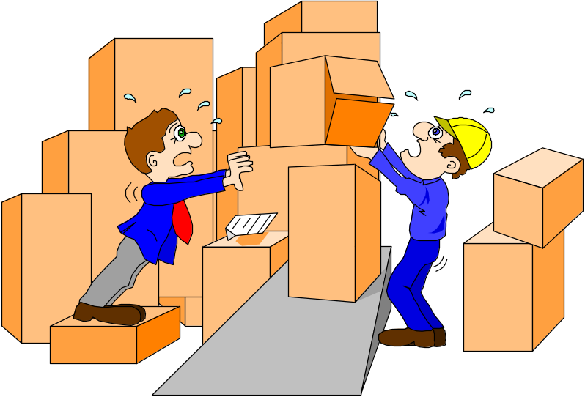
Why Learn Parts of Speech?
They are the building blocks of English grammar.
Understanding and applying a process is learning to learn.
It is a foundation to improve your writing.

Slide 4
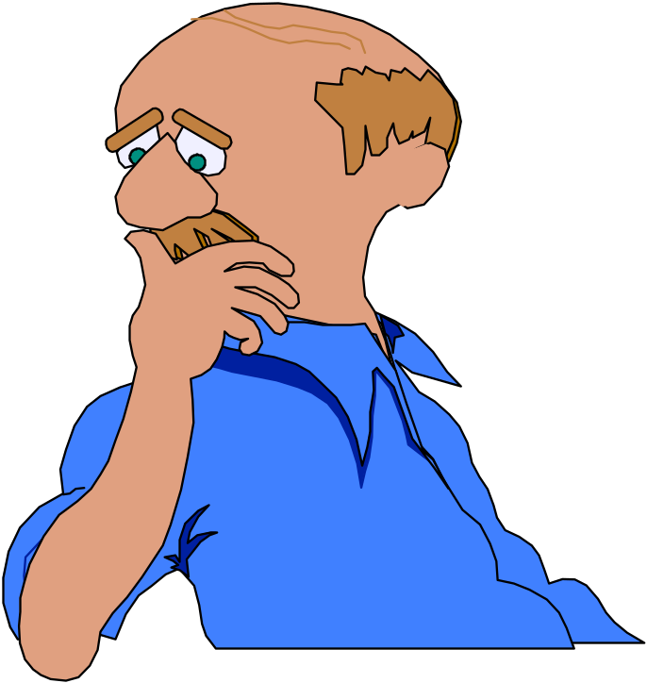
The Eight Parts of Speech
Nouns
Adjectives
Pronouns
Verbs
Conjunctions
Prepositions
Adverbs
Interjections

Slide 5
Nouns
Names of persons, places, things, feelings, or ideas. Can be
Common or Proper*
Example: John has a new car, and he parks on the street under a big tree in Filer.

Slide 6
Can be Concrete
(can be seen or touched)
Or
Abstract
(cannot be seen or touched
Examples:
desk, child, gumball
freedom, responsibility,
honesty, prejudice

Slide 8

Nouns
Can be compound
and written as:
Single word
Separate words
Hyphenated words
Examples:
homework, textbook, classmate, grandmother
pen pal, word processing, Maryann Smith, dining room
three-fourths, mother-in-law, sister-in-law, self-esteem

Slide 9

Pronouns
Take the place of a noun – acts as its substitute.
Examples:
Susan said that she was sorry.
Thomas claimed the pencil belonged to him. Later he realized that it belonged to Mark.

Slide 11
Pronouns
Can be
Demonstrative
THIS
THAT
THESE
THOSE
Examples:
This is mine.
That is yours.
These are broken.
Those are sweet.
Use your finger to “demonstrate”!

Slide 12
Nouns
Names of persons, places, things, feelings, or ideas.
Often indicated by “noun markers” -- a, an, and the.
Example: The boy on the red bike hit a bird with a rock at the end of the long road.

Slide 13
Nouns
Names of persons, places, things, feelings, or ideas.
“Noun markers” -- a, an, and the.
Noun endings: -ness, -ment, -ance, -ence, -ancy, -ency, -ity, -ion, -ure.
Example: Happiness is the preference of every action and is the tendency toward kindness and contentment.

Slide 14
Nouns
Names of persons, places, things, feelings, or ideas.
“Noun markers” -- a, an, and the.
Noun endings: -ness, -ment, -ance, -ence, -ancy, -ency, -ity, -ion, -ure.
Can be made plural with s or es.
Example: The needs of the masses may conflict with expectations of the members of legislative bodies.

Slide 15
Nouns
Names of persons, places, things, feelings, or ideas.
“Noun markers” -- a, an, and the.
Noun endings: -ness, -ment, -ance, -ence, -ancy, -ency, -ity, -ion, -ure.
Can be made plural with s or es.

Slide 16
Verbs
3 types of verbs:
    Action (a.k.a. Main Verb)
    Linking (a.k.a. Main Verb)
    Helping (introduces the main verb)

Slide 17
Verbs
The action or “doing” words in a sentence.
The horse ran, jumped and kicked until it threw the rider.
Most verbs make sense in the blanks below:
  He _________.
  They ________.

Slide 18
Verbs
The action or “doing” words in a sentence.
“Linking verbs” show being.
Example:
She is a nice person, and we are her friends.
Memorize the linking verbs:
Be, am, is, are, was,
were, been, being.

Slide 19
Verbs
The action or “doing” words in a sentence.
“Linking verbs” show being.
Change to show time (tense).
Example:
Today I am on a bus, and it goes past my house.
Yesterday I was on a bus, and it went past my house.
The words that change are verbs.

Slide 20
Verbs
The action or “doing” words in a sentence.
“Linking verbs” show being.
Change to show time (tense).
Complete verbs include “helping verbs.”
Always helping verbs:
Can Will Shall May
Could Would Should Might
Must
Always verbs, may be helping:
  Have, has, had
  Do, does, did, done
  Be, am, is, are, was, were, been, being

Slide 21
Verbs
The action or “doing” words in a sentence.
“Linking verbs” show being.
Change to show time (tense).
Complete verbs include “helping verbs.”
Example:
They might have been going to the store if they could have gotten a ride.

Slide 22
Verbs
The action or “doing” words in a sentence.
“Linking verbs” show being.
Change to show time (tense).
Complete verbs include “helping verbs.”

Slide 23
Adjectives
Describe or modify only nouns.
Example: A big, red dump truck hit a parked little car and the worried driver ran to the other side of the busy street.

Slide 24
Adjectives
Describe or modify only nouns.
Answer questions, “what kind?” or “how many?”
Example:
The three tired teens tried to eat a large pie at two pizza parlors.
How many teens? three
What kind of teens? tired
What kind of pie? large
How many parlors? two
What kind of parlors? pizza

Slide 25
Adjectives
Describe or modify only nouns.
Answer questions, “what kind?” or “how many?”
The “noun markers” a, an, the are always adjectives.
Example:
The way to a smile and an appreciative attitude is through the stomach.

Slide 26
Adjectives
Describe or modify only nouns.
Answer questions, “what kind?” or “how many?”
The “noun markers” a, an, the are always adjectives.
Usually “piled up” before nouns.
Example:
The long, shiny black limousine pulled in front of the huge old mansion, and a tall, well-dressed older gentleman got out.

Slide 27
Adjectives
Describe or modify only nouns.
Answer questions, “what kind?” or “how many?”
The “noun markers” a, an, the are always adjectives.
Usually “piled up” before nouns.
May follow linking verbs and describe the subject.
Example:
The river is deep, wide and cold, but the divers are brave and well-trained.
Note: to test these, try
putting them in front of
the noun they modify.

Slide 28
Adjectives
Describe or modify only nouns.
Answer questions, “what kind?” or “how many?”
The “noun markers” a, an, the are always adjectives.
Usually “piled up” before nouns.
May follow linking verbs and describe the subject.

Slide 29
Degrees of Adjective
Positive
Comparative
Sup erlative

Slide 30
The er and est
The more and most
The irregulars

Slide 31
Pronouns
Specialized words to take the place of nouns.
Example:
Paul gave Emily stationery because he wanted her to write to him when she could.

Slide 32
Pronouns
Specialized words to take the place of nouns.
Often refer to people and have several forms.
Memorize:
I he we she they
me him us her them
Other common pronouns:
  you, it, this, that, who, what, someone, everything, anyone, and many other similar words.

Slide 33
Pronouns
Specialized words to take the place of nouns.
Often refer to people and have several forms.
May be possessive, showing ownership and working like an adjective.
Example:
Her red car is faster than my old Ford, but their new Honda cost more than ours.
Note the form:
I he we she they
me him us her them
my his our hers theirs
Others: yours, its, whose

Slide 34
Pronouns
Specialized words to take the place of nouns.
Often refer to people and have several forms.
May be possessive, showing ownership and working like an adjective.

Slide 35
Prepositions PP
Some prepositions cannot be easily related to the mountain, such as
  of
  with
  about
  from
  as
Some prepositions are made up of 2 or more words, such as
  according to
  in between
  in spite of
  on top of
  in addition to

Slide 36

Prepositions PP
Common Prepositions:
aboard before down of throughout
about behind during on to
above below except onto toward
across beneath for opposite under
after beside from out underneath
against besides in outside until
along between inside over up
among beyond into past upon
around but (except) like since with
as by near through within
at

Slide 37
Prepositions
Specialized words to start prepositional phrases.
A prepositional phrase
is a group of words
describing things
which starts with a
preposition and ends
with a noun or pronoun.
The man on the bus with a hat on his head looked at me and turned toward the window.

Slide 38
Prepositions
Specialized words to start prepositional phrases.
Most prepositions are small, common words indicating time, place or position.
Memory clue:
The rabbit went _____
the hollow log.
Memorize:
at, from, to, on, in,
into, onto, between,
under, over, against,
around, through

Slide 39
Prepositions
Specialized words to start prepositional phrases.
Most prepositions are small, common words indicating time, place or position.
Some prepositions simply must be memorized.
Example:
The problem with him
is that he sleeps
during the day and
spends most of the
night with his friends.
Memorize:
of, with, for, during

Slide 40
Prepositions
Specialized words to start prepositional phrases.
Most prepositions are small, common words indicating time, place or position.
Some prepositions simply must be memorized.

Slide 41
Conjunctions
Words which “hook” words, phrases, or sentences.
Memory clue: FAN BOYS.
For But
And Or
Nor Yet
So
Example:
She and I left, but they
stayed, for Joe or Ted
was coming on the
bus, yet not on time.

Slide 42
Conjunctions
Words which “hook together” words, phrases, or sentences.
Some conjunctions only hook clauses.
They include:
when, as, if, since,
because, while, after,
although, before
Example:
I ran when I saw her
because I was happy
since she was home.
Memory clue:
She is cute _____ she smiles.

Slide 43
Conjunctions
Words which “hook together” words, phrases, or sentences.
Some conjunctions only hook clauses.

Slide 44

Correlative Conjunctions
Correlative Conjunctions
  Either ~ or
  Neither ~ nor
  Not only ~ but also
  Both ~ and
  Whether ~ or
Examples:
I’ll either walk or jog home.
Neither you nor I have blue eyes.
Not only do I like ELA, but I also like science class.
Leah earned an A in both math and religion.
We need to decide whether to leave or to stay.

Slide 45
Adverbs
Describe verbs, adjectives, or other adverbs.
She quickly ran to her extremely tired friend and gave him a very big hug.

Slide 46
Adverbs
Describe verbs, adjectives, or other adverbs.
Answer the adverb questions: How? When? Where? Why? Under what conditions?
Soon the very able pilot confidently flew west, and thus he almost crashed.
When? soon
Where? west
How? very,confidently
Why? thus
What conditions? almost

Slide 47
Adverbs
Describe verbs, adjectives, or other adverbs.
Answer the adverb questions: How? When? Where? Why? Under what conditions?
Often end in -ly
Example:
The extremely hungry
animal howled eerily in
the especially dark
night.

Slide 48
Adverbs
Describe verbs, adjectives, or other adverbs.
Answer the adverb questions: How? When? Where? Why? Under what conditions?
Often end in -ly
Always adverbs: not very, often, here, almost, always, never, there
Example:
We do not very often
want them here, for
they are always late
and almost never want
to go there with us.

Slide 49
Adverbs
Describe verbs, adjectives, or other adverbs.
Answer the adverb questions: How? When? Where? Why? Under what conditions?
Often end in -ly
Always adverbs: not very, often, here, almost, always, never, there

Slide 50
Interjections
Words which show emotion or are “fillers” with no other function.
Example:
Oh, I am surprised, but
please don’t do it
again. Ouch, you hurt
me.

